Slide 1
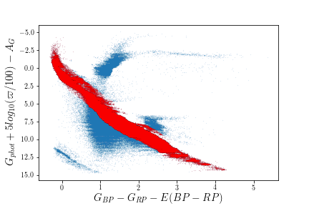
H-R diagram
What sample we are using?
Parallax > 2
Parallax_error/parallax<0.1
phot_bp_mean_flux_over_error > 10
phot_rp_mean_flux_over_error > 10
Total sample count: 12899067
Main sequence stars count: 6158038

Slide 2
Recap: <mu_l>, <mu_b>,<vlos> vs l

Slide 3
Key Equations
A)
B)
C)

Slide 4
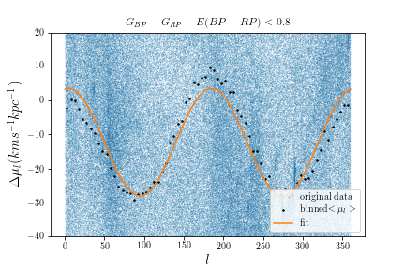
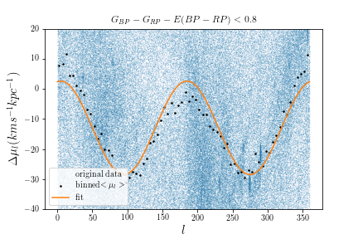
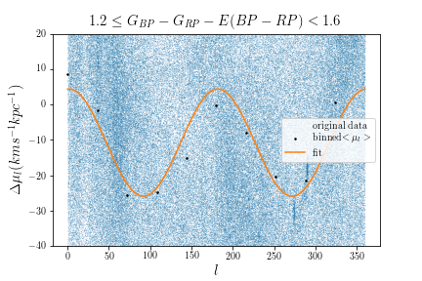
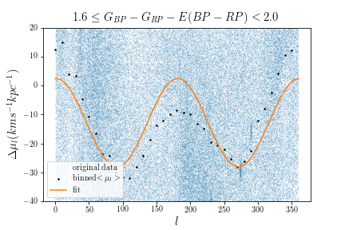
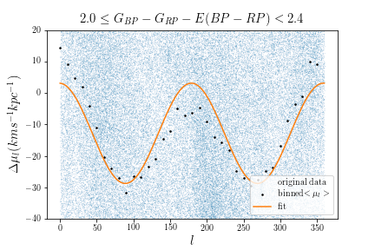
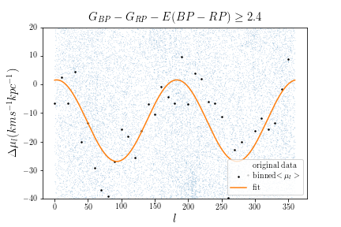
Mu_l: Binned by 10 degree
(Li: 36degree per bin)
(Bovy:360/45 = 8 degree per bin)

Slide 5
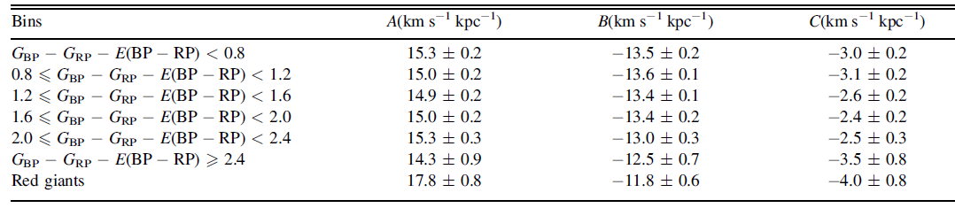
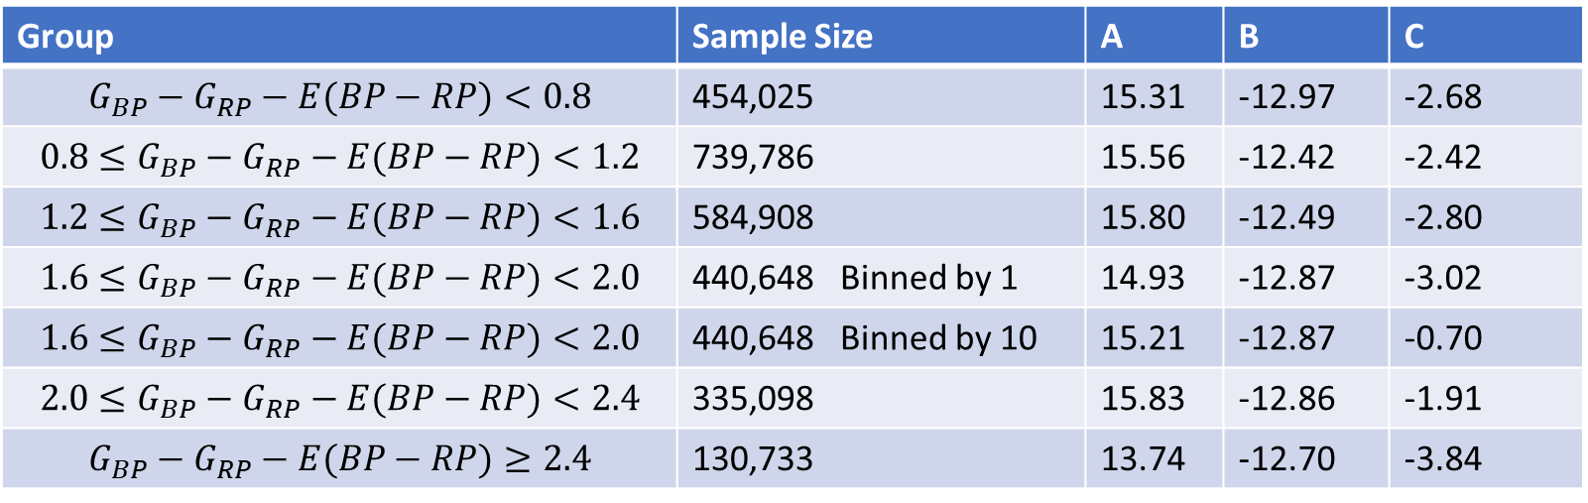

$$μ_{l}$$
Uncertainties of all parameters for each group have not bee calculated using my MCMC program
Group | Sample Size | A | B | C
$$G_{BP}−G_{RP}−E(BP−RP)<0.8$$ | 454,025 | 15.31 | -12.97 | -2.68
$$0.8≤G_{BP}−G_{RP}−E(BP−RP)<1.2$$ | 739,786 | 15.56 | -12.42 | -2.42
$$1.2≤G_{BP}−G_{RP}−E(BP−RP)<1.6$$ | 584,908 | 15.80 | -12.49 | -2.80
$$1.6≤G_{BP}−G_{RP}−E(BP−RP)<2.0$$ | 440,648 Binned by 1 | 14.93 | -12.87 | -3.02
$$1.6≤G_{BP}−G_{RP}−E(BP−RP)<2.0$$ | 440,648 Binned by 10 | 15.21 | -12.87 | -0.70
$$2.0≤G_{BP}−G_{RP}−E(BP−RP)<2.4$$ | 335,098 | 15.83 | -12.86 | -1.91
$$G_{BP}−G_{RP}−E(BP−RP)≥2.4$$ | 130,733 | 13.74 | -12.70 | -3.84
Li, 2019

Slide 6
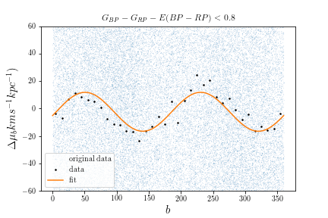
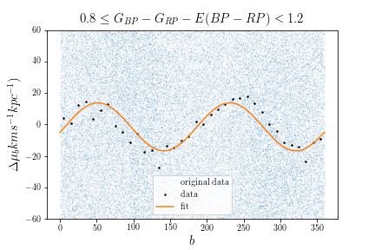
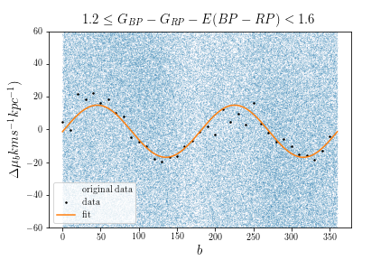
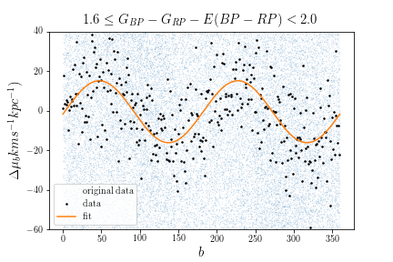
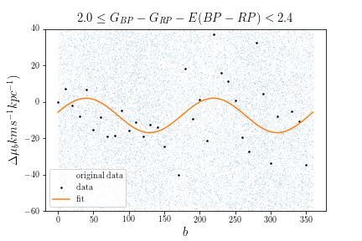
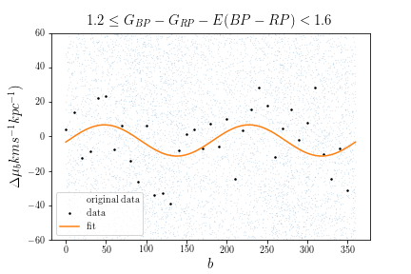
Mu_b: Binned by 10 degree
(Li: 36degree per bin)
(Bovy:360/45 = 8 degree per bin)
$$G_{BP}−G_{RP}−E(BP−RP)≥2.4$$
(Binned by 1 degree)

Slide 7
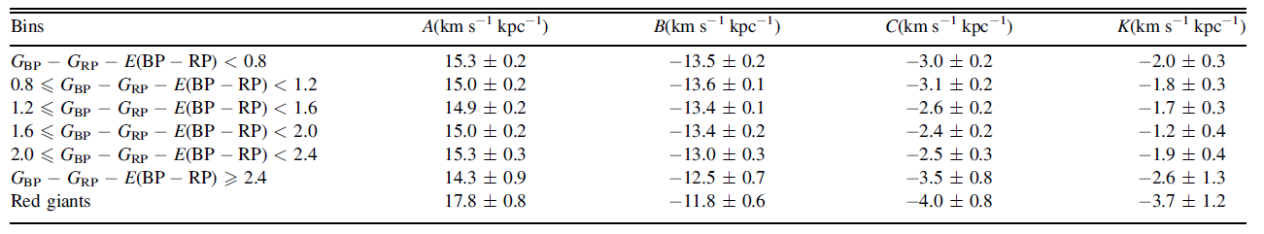

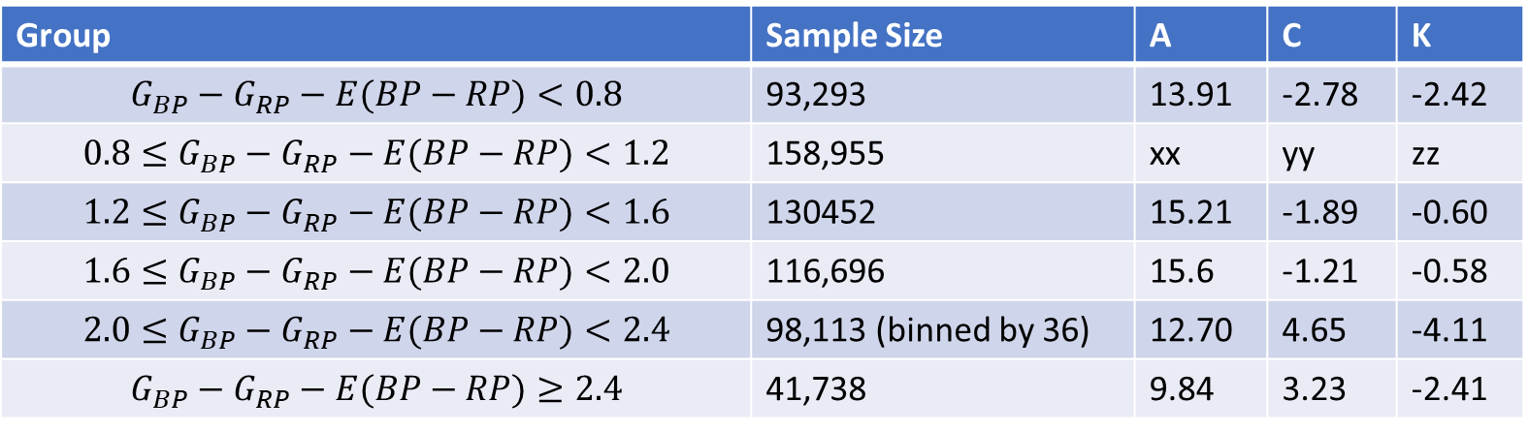
$$μ_{b ,}40<\left|b\right|<50$$
Uncertainties of all parameters for each group have not bee calculated using my MCMC program
Group | Sample Size | A | C | K
$$G_{BP}−G_{RP}−E(BP−RP)<0.8$$ | 93,293 | 13.91 | -2.78 | -2.42
$$0.8≤G_{BP}−G_{RP}−E(BP−RP)<1.2$$ | 158,955 | xx | yy | zz
$$1.2≤G_{BP}−G_{RP}−E(BP−RP)<1.6$$ | 130452 | 15.21 | -1.89 | -0.60
$$1.6≤G_{BP}−G_{RP}−E(BP−RP)<2.0$$ | 116,696 | 15.6 | -1.21 | -0.58
$$2.0≤G_{BP}−G_{RP}−E(BP−RP)<2.4$$ | 98,113 (binned by 36) | 12.70 | 4.65 | -4.11
$$G_{BP}−G_{RP}−E(BP−RP)≥2.4$$ | 41,738 | 9.84 | 3.23 | -2.41
Li, 2019

Slide 8
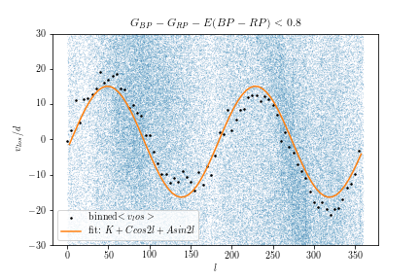
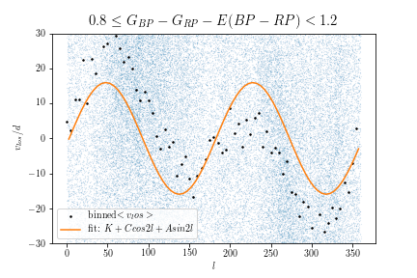
V_los, fewer entries, only the first two subgroups have enough samples with v_los measurements.

Slide 9
What |b| range is appropriate?
For mu_l, the uncertainties calculated from my current MCMC is larger if |b| covers a larger range.
For mu_b, only 40<|b|<50 is good.
Conclusion: for mu_l, select |b|<20;
For mu_b, select 40<|b|<50

Slide 10
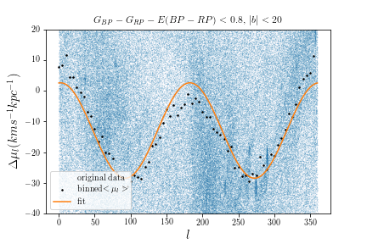
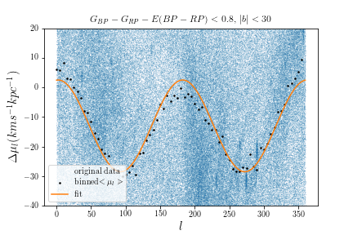
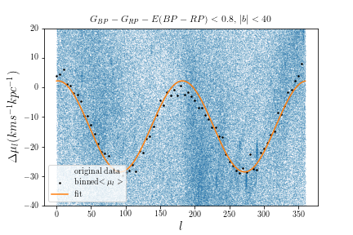
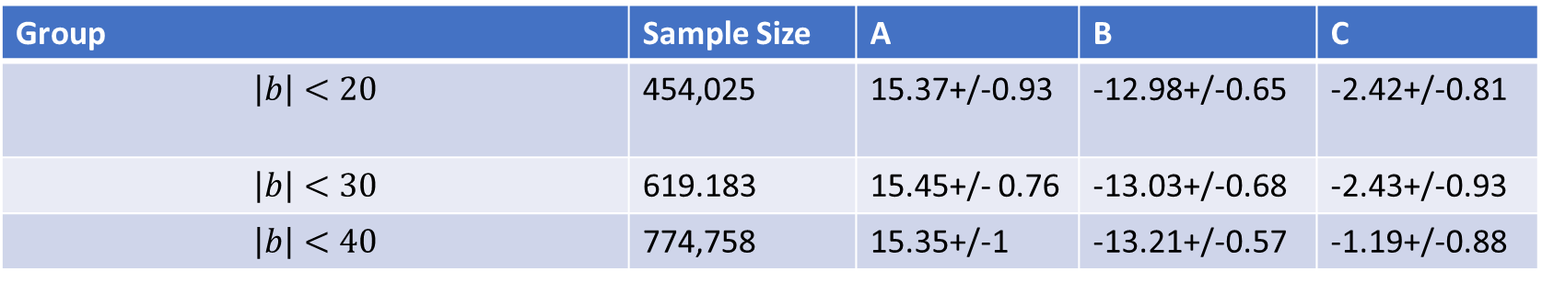
$$μ_{l}$$
Increase/decrease b range
Group | Sample Size | A | B | C
$$\left|b\right|<20$$ | 454,025 | 15.37+/-0.93 | -12.98+/-0.65 | -2.42+/-0.81
$$\left|b\right|<30$$ | 619.183 | 15.45+/- 0.76 | -13.03+/-0.68 | -2.43+/-0.93
$$\left|b\right|<40$$ | 774,758 | 15.35+/-1 | -13.21+/-0.57 | -1.19+/-0.88

Slide 11
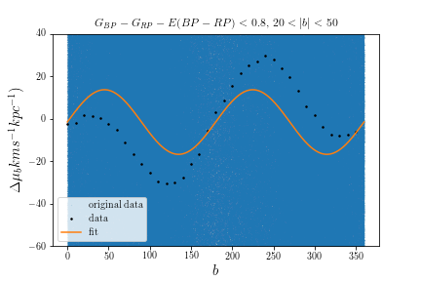
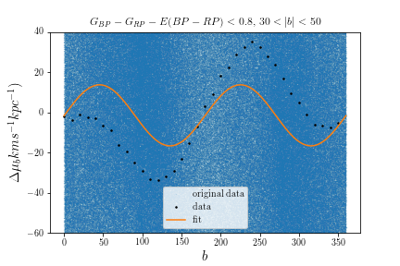
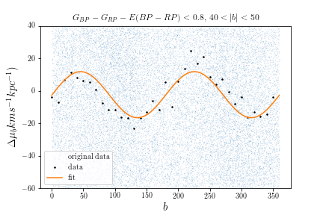

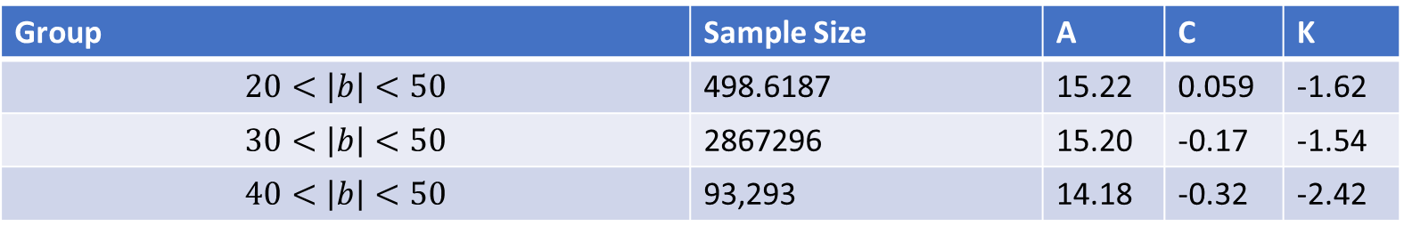
$$μ_{b ,}40<\left|b\right|<50$$
Increase/decrease b range
Group | Sample Size | A | C | K
$$20<\left|b\right|<50$$ | 498.6187 | 15.22 | 0.059 | -1.62
$$30<\left|b\right|<50$$ | 2867296 | 15.20 | -0.17 | -1.54
$$40<\left|b\right|<50$$ | 93,293 | 14.18 | -0.32 | -2.42

Slide 12
MCMC
I tried using different number of mean mu_l and mu_b to do MCMC. And I found I had to use more data points to make the Markov Chain converge. This means bins size is small. I used 1 deg.
In previous investigation, I found bin size does not affect the fitting result, but how obvious the sin2l or cos2l trend is.
I think the choice of using 1-5 deg bin size to find mean mu_l/mu_b is validated.
However, the uncertainty in the parameters from our fit is larger than Li and Bovy’s result.
I am still not sure if I am using the right way to find errors of the quantity I am fitting against l.

Slide 13
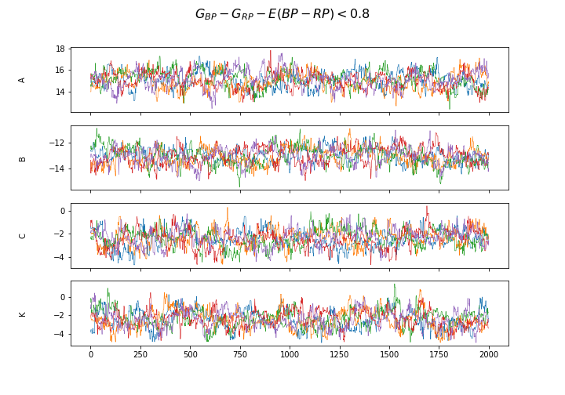
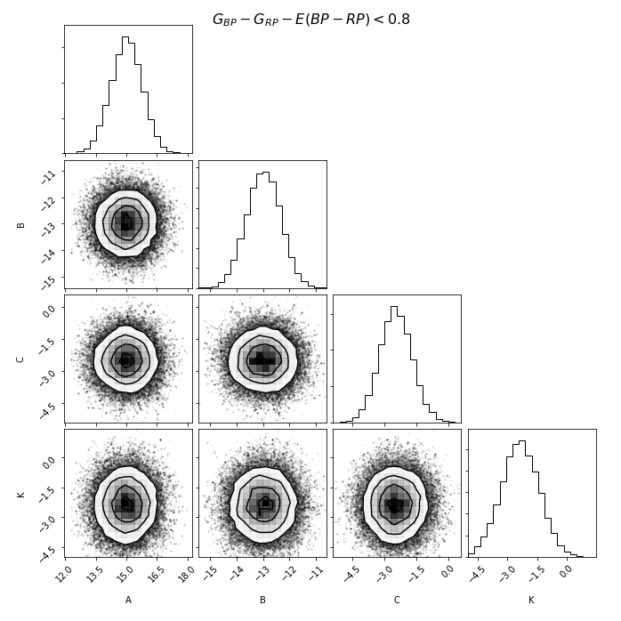
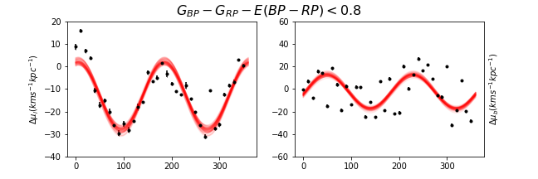
A: 15.00+/- 0.66
B: -12.96+/- 0.56
C: -2.36+/- 0.75
K: -2.45+/-0.93

Slide 14
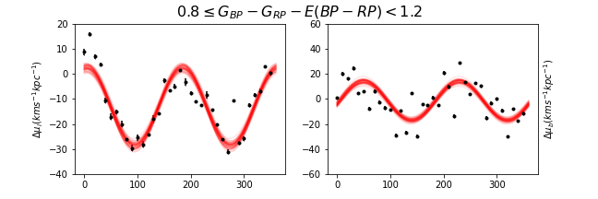
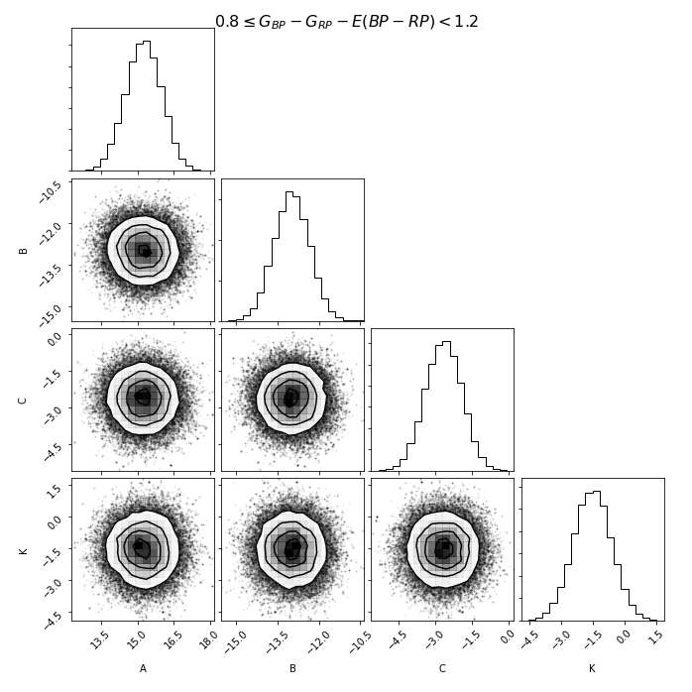
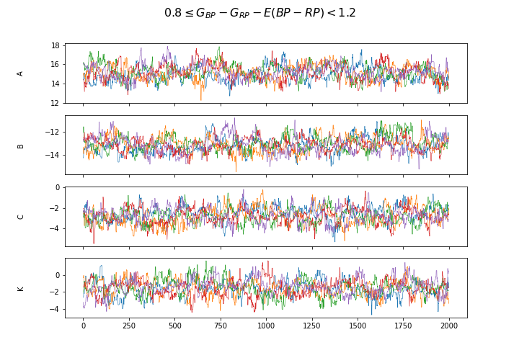
A: 15.23 +/- 0.75
B: -12.89+/- 0.54
C: -2.70 +/- 0.75
K: -1.61+/-1.16

Slide 15
Phase plot
we are interested in the sub features on our mu_l /mu_b vs l plot
we notice the value at l=180 deg looks significantly lower than the values at l=0 and 360 deg. This is not aligned with the Oort constants model.
Peculiar motion of the sun contribute to a sinl/cosl pattern to the proper motion of the stars, which is distinct from the sin2l/cos2l due to shearing/vorticity in azimuthal direction. (I believe this sinl/cosl is already subtracted in my fitting)
We are confused about the decreasing/shifting-downward pattern in the vlos_l result
I made some attempts to look at the phase plots. They are really questionable.

Slide 16
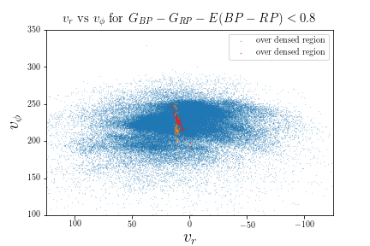
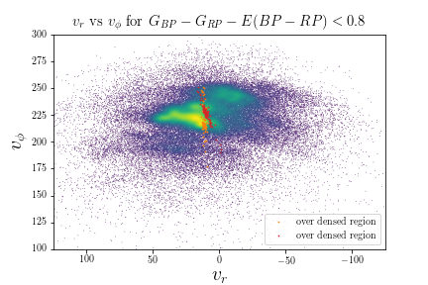
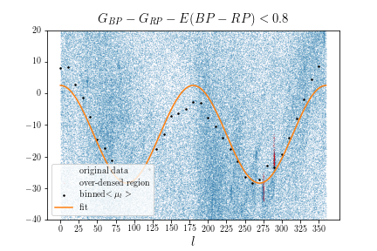
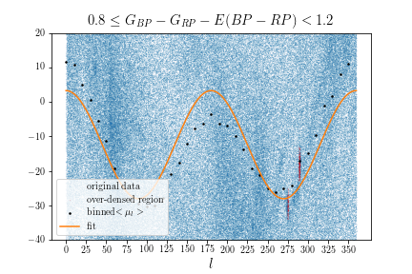
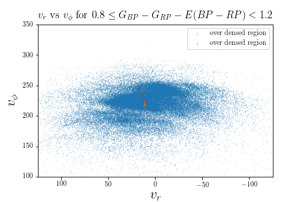
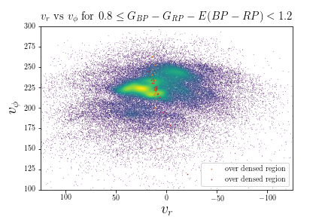

Slide 17
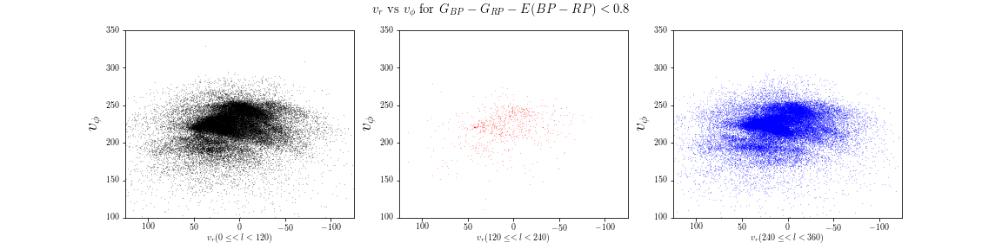
Vphi vs vr Phase plots by longitude range

Slide 18


Vphi vs vr Phase plots by longitude range

Slide 19
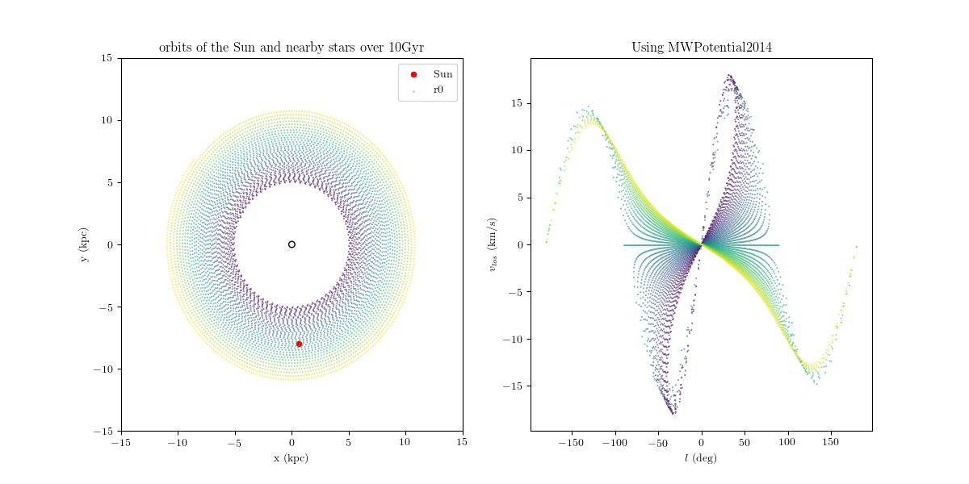
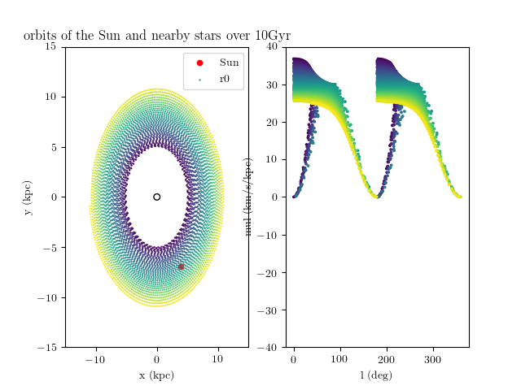
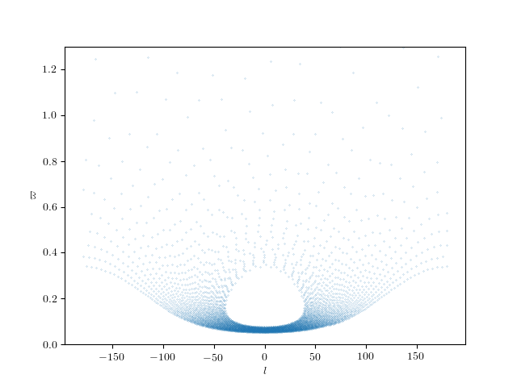

Slide 20
